Slide 1
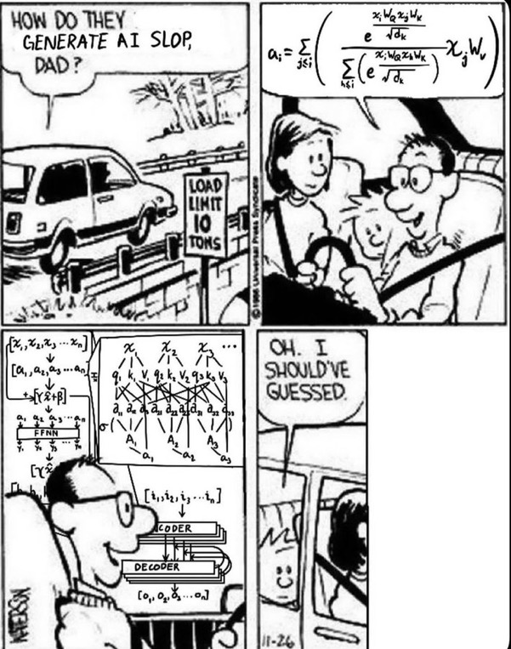
Meme of the Day

Slide 2
Lab 01 was “due”
How was it??
I think a Lab 00 with “workflow” tips could have been useful
Lab 02 is available but based on feedback I can/will change things
Goal is low floor/high ceiling

Slide 3
CSE 10124 Recurrent Neural Networks

Slide 4
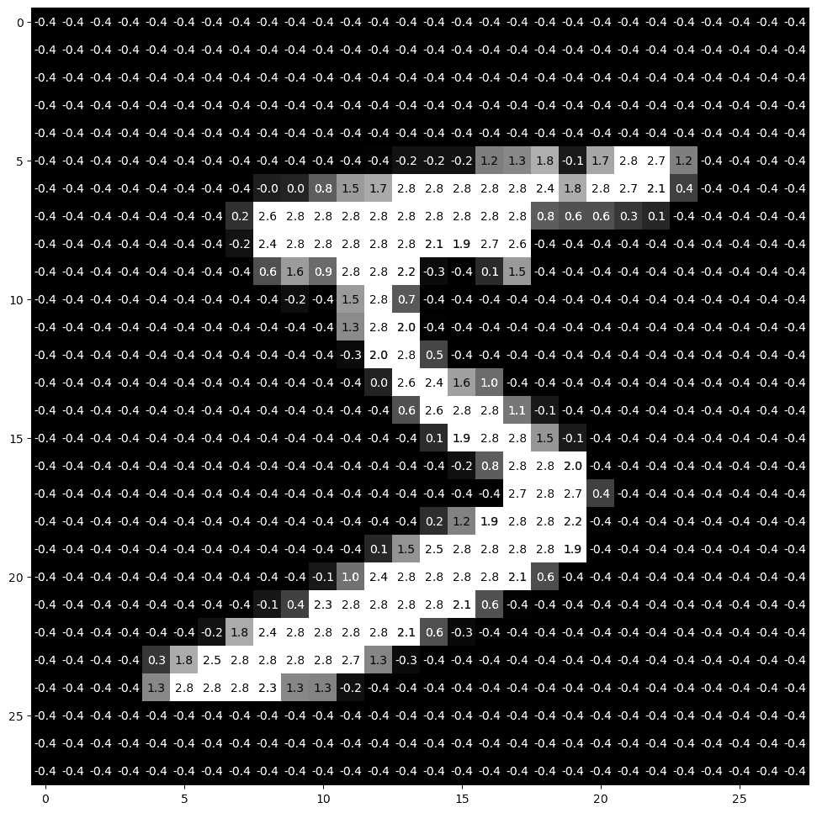
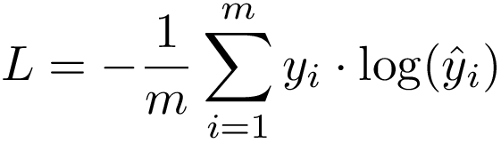
Writing MNIST “Equations”
<
…
…
>
X = <1, 784>
X⍵^{T} + b)
ŷ = X ⍵^{T} + b
<1, 10> = <1, 784> ᐧ <784, 10> + <1, 10>
y = <1, 10>
<0, 0, 0, 0, 0, 1, 0, 0, 0, 0>
0, 1, 2, 3, 4, 5, 6, 7, 8, 9
= 5

Slide 5
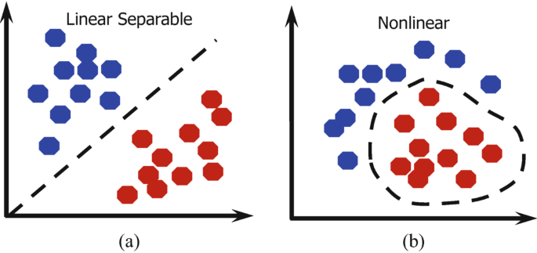
Non-linearity
Not all data can be separated with a straight line!

Slide 6
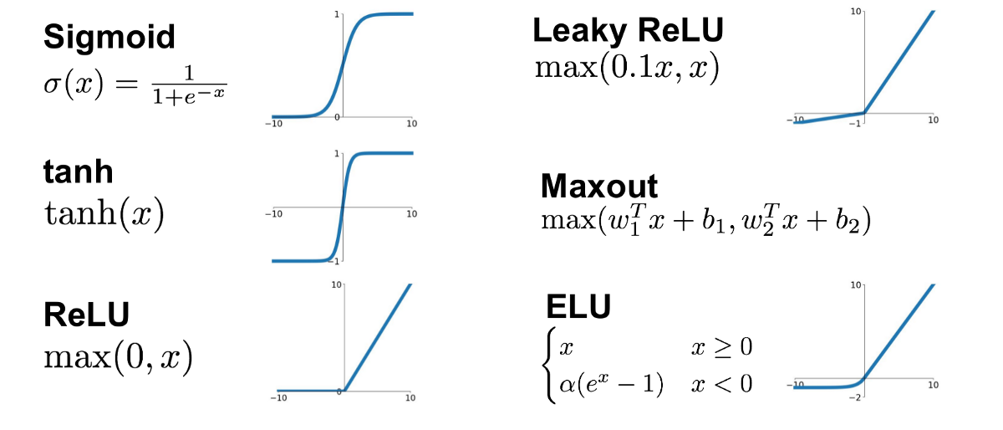
Activation Functions
We can add non-linearity to our network by wrapping our linear transformations in nonlinear functions called activation functions

Slide 7
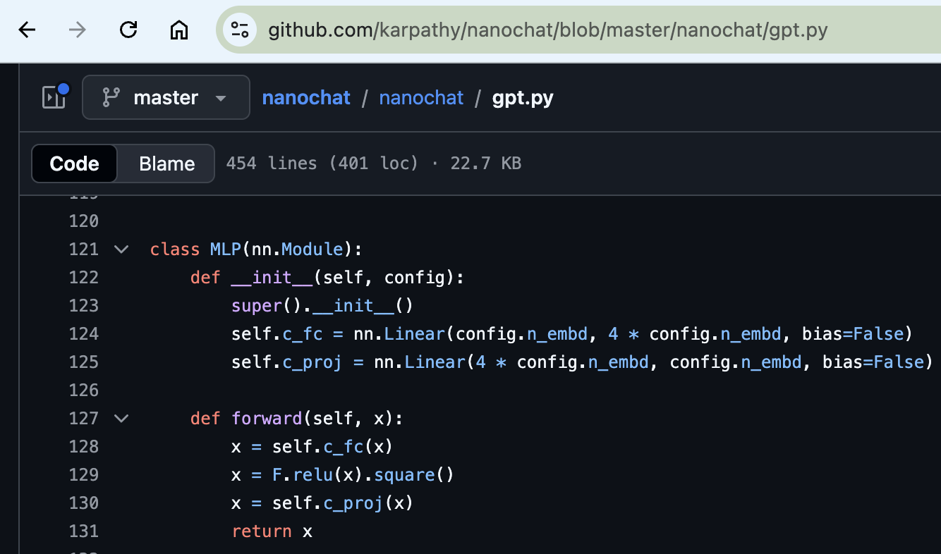
nanochat - MLP

Slide 8

Convolutional Neural Networks

Slide 9
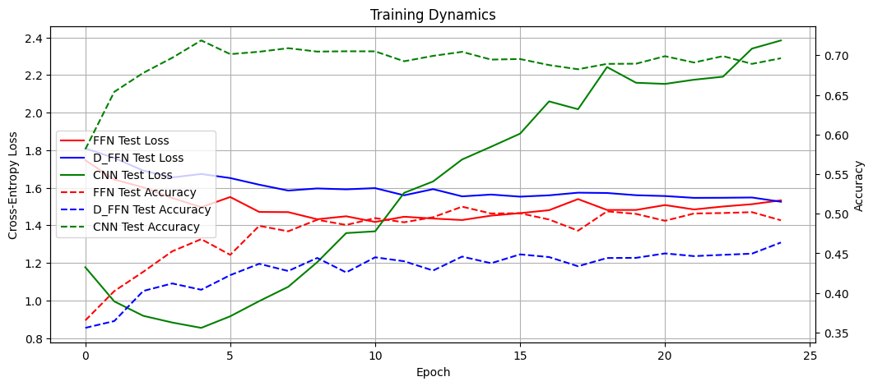
FFN vs. FFN + Dropout vs. CNN

Slide 10
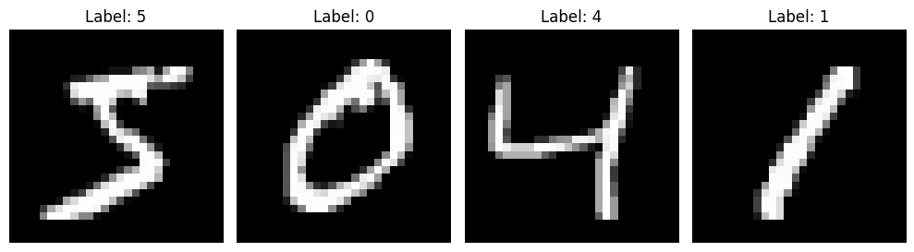
Image vs. Text Data
Whether an image of a 5 came before the 0 has no impact on how we predict the 0.
However, for text, what came previously matters a LOT
I
like
cute
kittens
and

Slide 11

Recurrent Neural
Networks
“like”
“cute”
“...”
“puppies”
tokenizer.decode(0)
tokenizer.decode(4)
…
tokenizer.decode(6)
yt₁ = 0
yt₂ = 4
yt_{t+1} = 6
<0.18, 0.14, 0.13, 0.12, 0.10, 0.09, 0.08, 0.07, 0.05, 0.04>
<0.11, 0.16, 0.13, 0.21, 0.10, 0.08, 0.07, 0.06, 0.05, 0.03>
…
<0.07, 0.15, 0.14, 0.10, 0.09, 0.08, 0.25, 0.05, 0.04, 0.03>
y₁ = softmax(b_{y} + h₁w_{y})
tanh(h₀w_{h}+ ex₀w_{x} + b_{h}) = h₁
y₂ = softmax(b_{y} + h₂w_{y})
tanh(h₁w_{h}+ ex₁w_{x} + b_{h}) = h₂
y_{t+1} = softmax(b_{y} + h_{t}w_{y})
tanh(h_{t-1}w_{h}+ ex_{t}w_{x} + b_{h}) = h_{t}
h₀
ex₀ = embeddings[xt₀]
ex₁ = embeddings[xt₁]
ex_{t} = embeddings[xt_{t}]
[xt₀, xt₁, …, xt_{t}] = tokenizer(X)
X = “I like cute kittens and”

